Slide 1
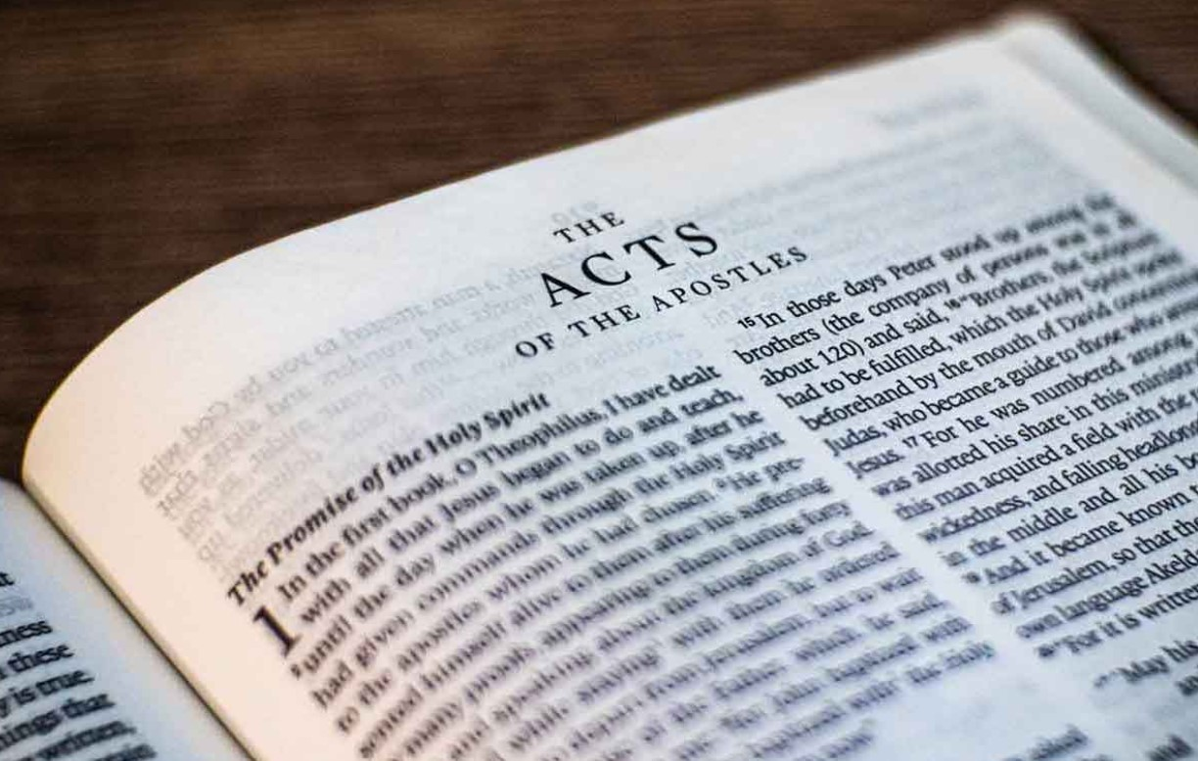
Go Tell The Good News
Acts – Part II

Slide 2
1)
2)
3)
4)
5)
6)
7)
8)
9)
10)
11)
12)
13)
14)
15)
Ascension & Appointment
Philippian Prison
16)
17)
18)
19)
20)
21)
22)
23)
24)
25)
26)
27)
28)
Pentecost & Peter’s Preaching
Addressing Athens
Lame Man & Lesson
Achaia, Antioch, & Apollos
Restrained, Released, & Request
Re-baptism, Repentance, & Riot
Deception & Detention
Macedonia & Miletus
Seven Selected
Jerusalem & Jewish Mob
Stephen Stoned
Review & Rejection
Samaria & Salvation
Council & Conspiracy
Saul Saved & Dorcas Delivered
Caesarean Confinement
Cornelius Converted
Report & Relief
A
Persecution, Peter, & Pride
CTS
Antioch to Iconium
F
Iconium to Antioch
ACTS
Disagreement & Decision
Alliteration Memory Statements To Help Recall Chapter Content

Slide 3
Today’s class:
Acts 23:25 - 24:27
Claudius Lysias, Roman Commander, sends letter to Felix
Accusation against Paul by the Jews from Jerusalem
Paul’s defense before Felix
Procrastination of Felix

Slide 4
Paul in Jerusalem
Summary
  Falsely accused of desecrating the temple by allowing a Greek inside
  Saved by Roman guard in court of Gentiles
  Summary of Paul’s defense before the people (until the mention of “Gentiles”)
  Paul’s defense before the council (“I am a Pharisee, the son of a Pharisee; concerning the hope and resurrection of the dead I am being judged”)
  The Lord stood by Paul (Acts 23:11)

Slide 5
Paul in Jerusalem
Summary
  The vow to kill Paul
  Claudius Lysias, commander of Roman forces in Jerusalem, sends Paul to Caesarea to Felix, governor of Judea
  The Commander directs resources to ensure Paul is kept safe
  The entourage, almost 500 soldiers and Paul, leaves Jerusalem and travels to Antipatris.
  The horsemen and Paul continue to Caesarea

Slide 6
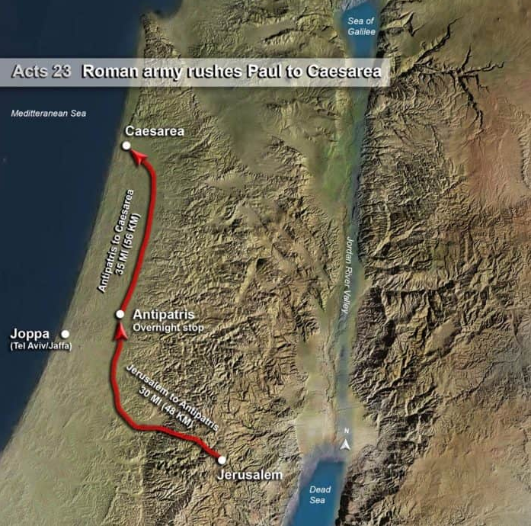
Antipatris: founded by Herod the Great around 9 BC, and it served as a significant military and administrative center. The city was strategically important due to its location on the Via Maris (Way of the Sea), an ancient trade route that connected Egypt with the northern empires of Syria, Anatolia, and Mesopotamia. This made Antipatris a vital link in the network of Roman roads, facilitating the movement of troops, goods, and information across the region.
Antipatris:
Acts 23:31

Slide 7
Caesarea: In ancient times, it boasted one of the world’s largest artificial harbors and was a center of Roman governance in the region. It was originally a small Phoenician town known as Straton’s Tower, and it was aggressively developed by Herod the Great into a major port city. Herod oversaw the construction of a massive artificial harbor, one of the largest in the world at the time, called Sebastos. Both the city of Caesarea and the harbor of Sebastos were named after Herod’s patron, Augustus Caesar (Sebastos being the Greek equivalent of Augustus). In addition to the artificial harbor, Herod built magnificent theaters, a palace, and an aqueduct.
Caesarea:
Acts 23:33

Slide 8
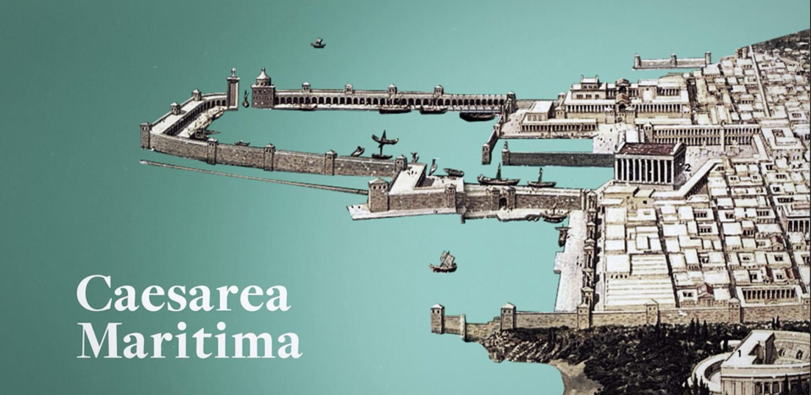
Caesarea: Acts 23:33

Slide 9
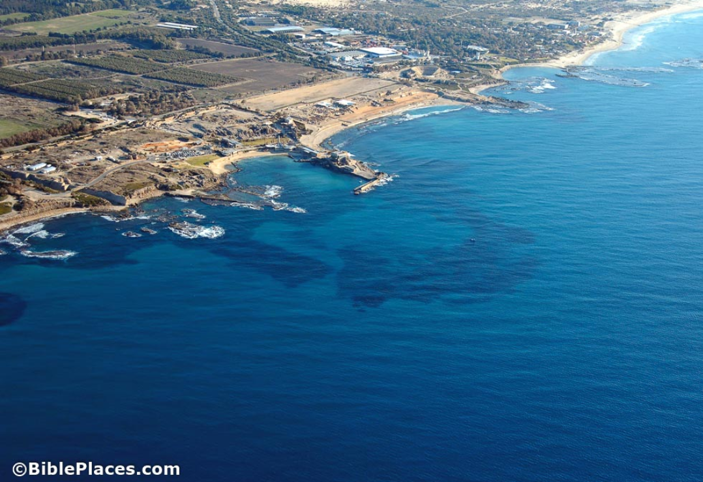
Caesarea: Acts 23:33

Slide 10
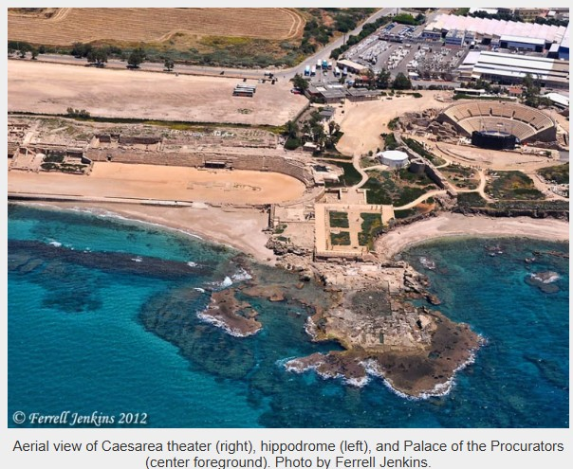
Caesarea: Acts 23:33

Slide 11
Acts 23:23-35
  Claudius Lysias’ (Roman Commander at Jerusalem) letter to Felix, governor of Judea and Samaria
  Paul placed in Herod’s Praetorium

Slide 12
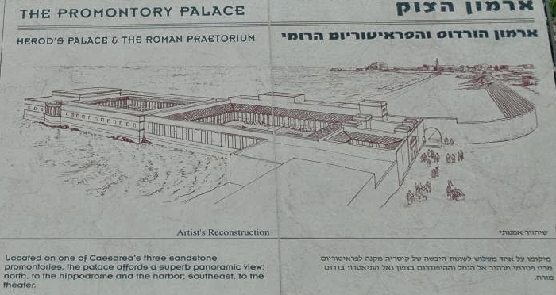
Caesarea: Acts 23:35

Slide 13
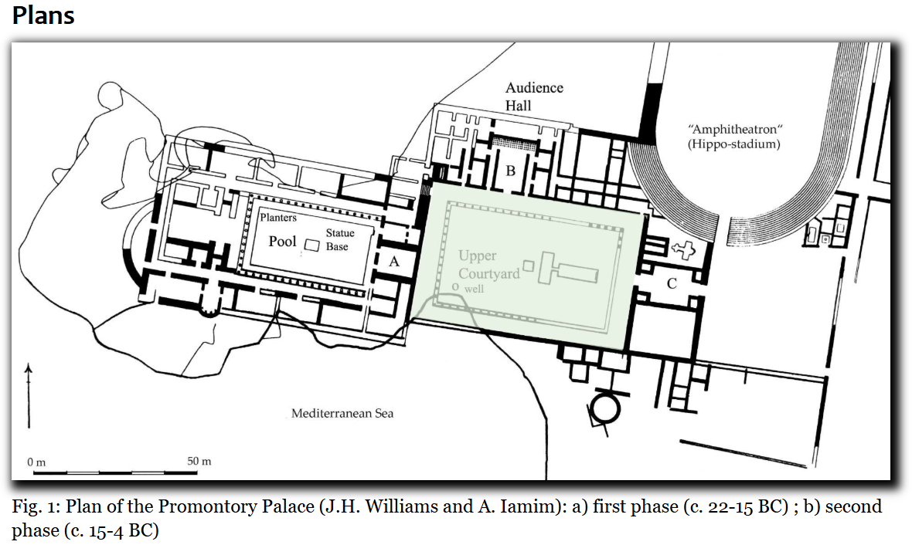
Caesarea: Acts 23:35

Slide 14
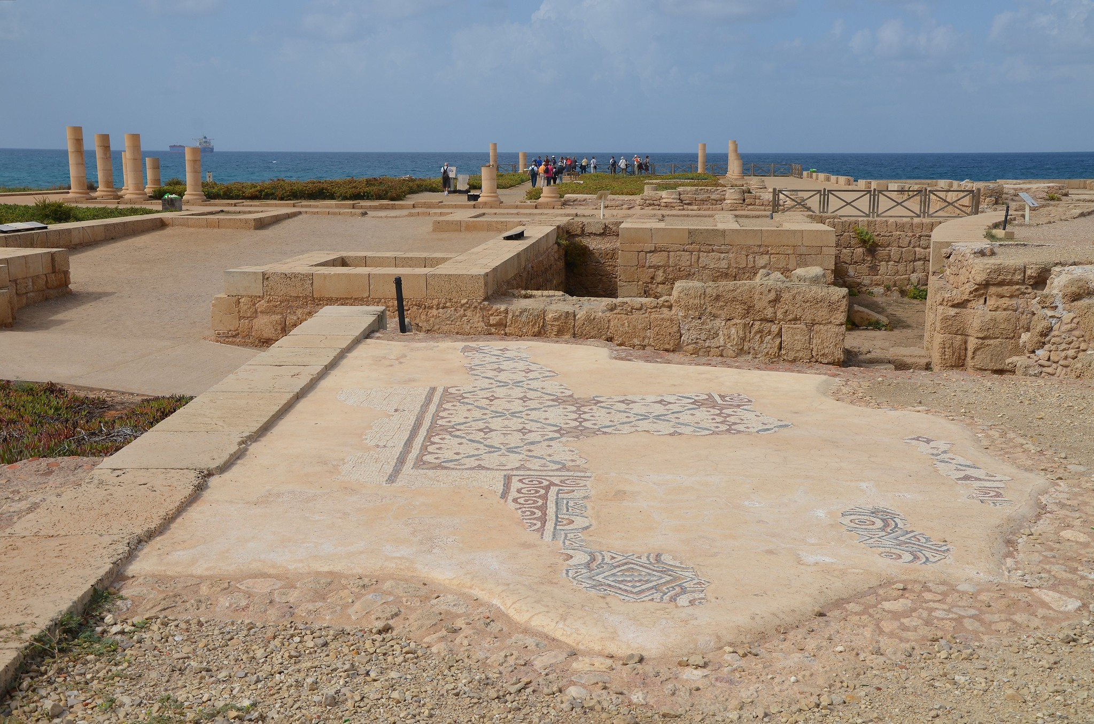
Caesarea: Acts 23:35
The Promontory Palace of Herod the Great stretching into the sea, Caesarea, Israel.

Slide 15
Acts 23:23-35
  Claudius Lysias’ (Roman Commander at Jerusalem) letter to Felix, governor of Judea and Samaria
  Paul placed in Herod’s Praetorium
  Paul waits for his accusers to arrive in Caesarea

Slide 16
Antonius Felix (Acts 23-24)
Antonius Felix served as the Roman procurator of Judea from approximately AD 52 to AD 60.
Roman procurators were responsible for maintaining order, executing Roman law, and collecting taxes.
His rule was characterized by harsh measures against dissent and widespread corruption. He was known for accepting bribes and using extreme violence to suppress crime.
Married 3 times
Felix was eventually recalled to Rome around AD 60, facing accusations of mismanagement and violence against the Jewish population.

Slide 17
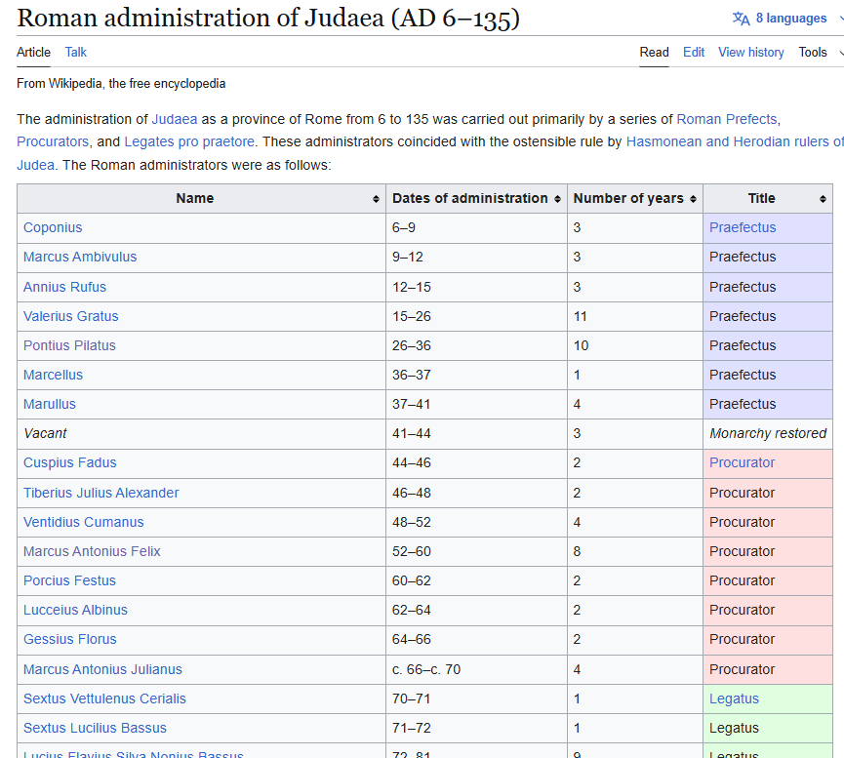
Praefectus: fairly low to high-ranking, military or civil officials in the Roman Empire, whose authority was not embodied in their person (as it was with elected Magistrates) but conferred by delegation from a higher authority.
Procurator: title of certain officials (not magistrates) in ancient Rome who were in charge of the financial affairs of a province, or imperial governor of a minor province.[
Legatus: the official title of the governor or general of some Imperial provinces of the Roman Empire during the Principate era, normally the larger ones or those where legions were based.

Slide 18
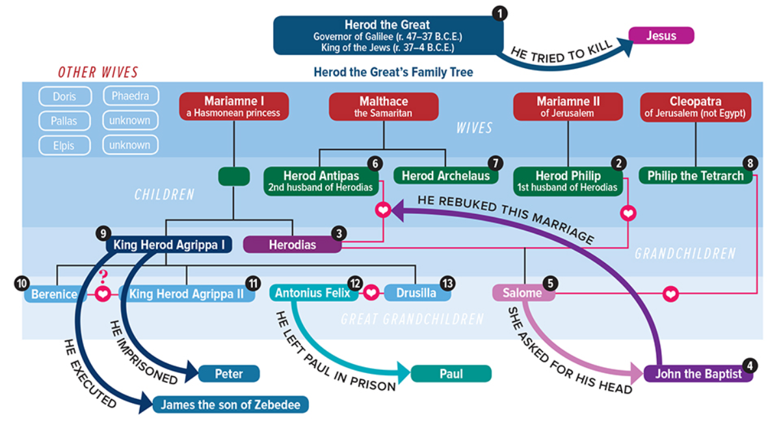
Drusilla (Acts 24:24)

Slide 19
Acts 24:1-9; Paul in Caesarea
  After 5 days, the high priest (Ananias) comes down to Caesarea with the elders and an orator named Tertullus
  Tertullus begins his accusations with words of flattery to Felix, and then insulting and abusive language toward Paul
  The Jews who had traveled to Caesarea concur with the accusations of Tertullus

Slide 20
Acts 24:10-21; Paul in Caesarea
  Paul initiates his defense with respect to Felix
  He challenges the charges that were laid out against him
  He discusses how he worships the God of his fathers, believing in all things which are written in the Law and in the Prophets
  He has hope in God
  He is striving to have a good conscience toward God and men
  He questions why the Jews who falsely accused him in Jerusalem were not in Caesarea

Slide 21
Acts 24:22-27; Paul in Caesarea
  Felix, hearing the defense of Paul, adjourns the proceedings and places Paul under house arrest while he waited on Lysias to come to Caesarea to make a decision
  He commands the centurion to allow Paul’s friends to provide for him and visit him
  Felix calls for Paul and heard him concerning the faith in Christ
  Paul reasons with Felix & Drusilla about righteousness, self-control, and the judgment to come
  Felix was afraid, but procrastinates
  Paul remains in Caesarea for 2 years

